Slide 1
Coursera Capstone Project
Exploring and comparing London Boroughs for prospective buyers

Slide 2
Business problem
London is a very diverse and expensive city.
As a result, for those who are already pressed for time, or who don’t know the city, finding a place to stay can be very daunting
This project aims to cluster neighbourhoods based on their most popular facilities using data from Foursquare
Subsequently, average house price data will be analysed so that an individual can compare similar neighbourhoods

Slide 3
Methodology
Data wrangling/cleansing
Two online sources of data
Web-scraped data must be cleaned, read into a dataframe, and converted to the correct data type
Political control had to be converted into categorical data
Exploratory data visualisations
Exploration of the geographical spread of clusters
Box plot to understand changes in house price based on political control of borough
Regression analysis of political control
Correlation calculated between political control and average house prices

Slide 4
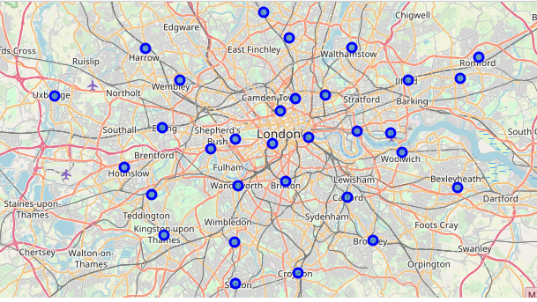
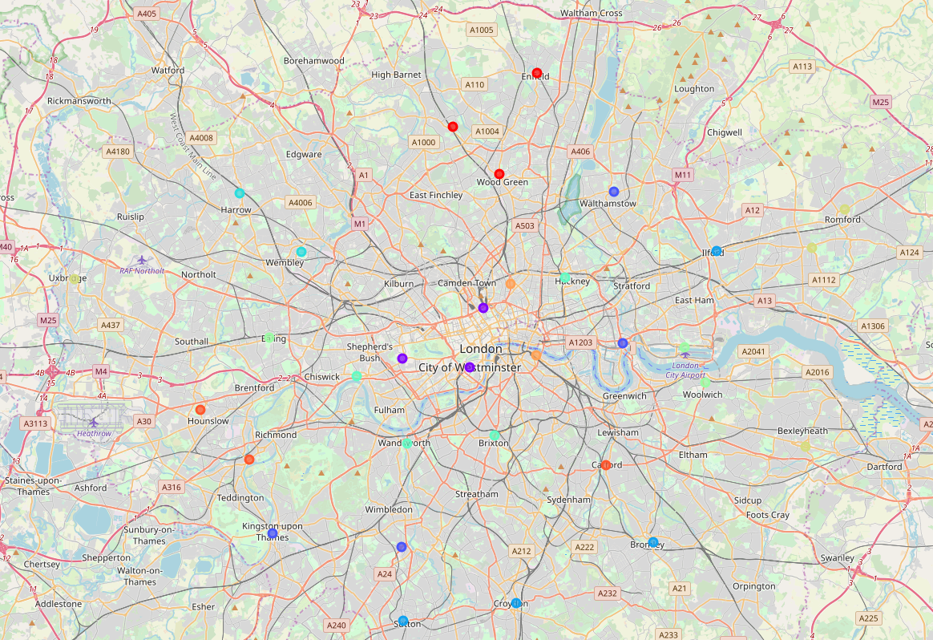
Data visualisations - Boroughs
A spatial representation of the clusters
A map of the Boroughs of London

Slide 5
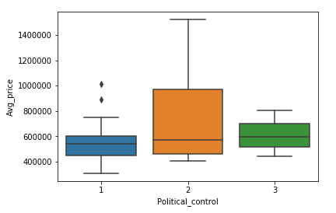
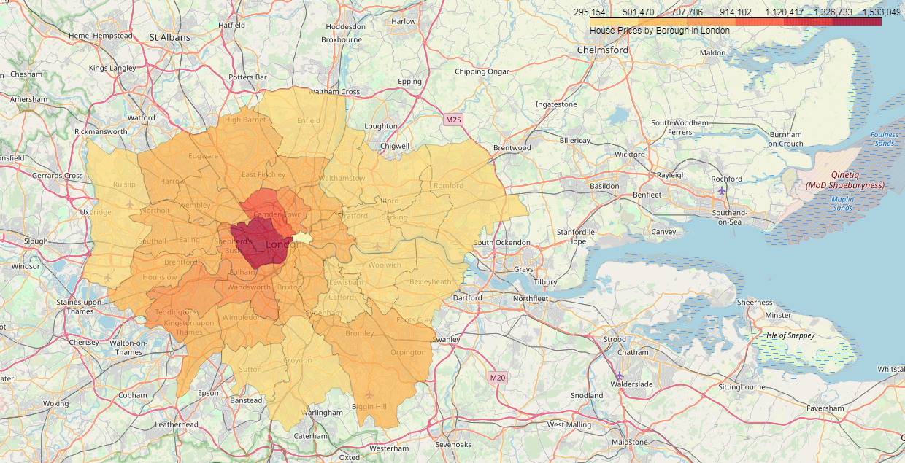
Data visualisations – House Prices
A choropleth map showing average house prices by borough
A boxplot exploring average house price by political control

Slide 6
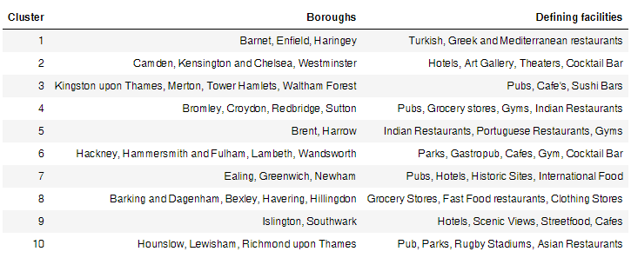
Results
Clustered boroughs and their defining facilities
Mediterranean food predominates – reflective of the population?
Central London boroughs, known for cultural attractions and tourism
Gentrified boroughs – classified by their emphasis on street food and cafes, as well as scenic views
Western boroughs with more open space and sporting arenas

Slide 7
Analysis
There is a clear influence on facilities present in a borough based on their geographical location.
Areas more central to the city are dominated by tourist features
Westwards of the city, which has more open space, is characterised by sports stadiums
Newly re-generated boroughs are classified by cafes, scenic views, and international street food.
Clusters are also influenced by the East/West divide of London with the East being historically less well-developed. However as these are the areas of regeneration it makes sense that clusters are still similar.
Clusters are grouped loosely in concentric circles moving away from the city center

Slide 8
Conclusion and future research
Cluster analysis gives good indication of the features of the boroughs and acts as a good method of selecting similar areas
Further research should be done to add extra granularity to the comparisons
This includes population data such as average income, ethnicity and age

